Slide 1
Memory Allocation
Algorithm and programming
Shania Priccilia, S.Kom., M.Kom.

Slide 2
Learning Objectives
At the end of this session, student will be able to:
Demonstrate usage of static and dynamic memory allocation in a C program (LO2 & LO3)

Slide 3
Subtopics
Static variable
Void * data type
Command Line Argument
Command Execution
Memory Allocation
Macro
Pointer to Function
C Preprocessor Directive
Exercise

Slide 4
Static keyword
definition
Keyword static can be used as variable type, or return value type of a function
Static variable:
  Allocated at program start and de-allocated at the end of a program
  Default value = 0
  Scope of static variable is inside a file where the variable is defined
Syntax:
  static type variable_name;
Example:
  static int x;

Slide 5
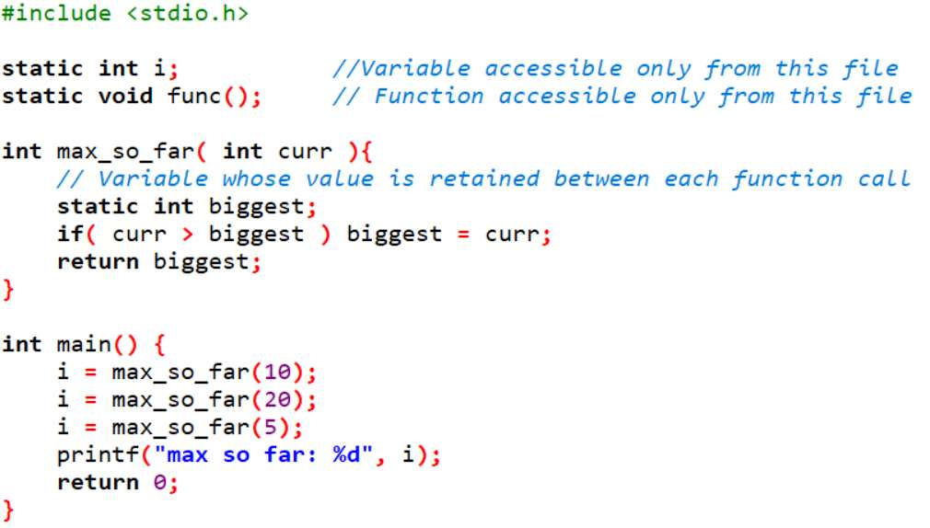
Static keyword
example
Output:
max so far: 20

Slide 6
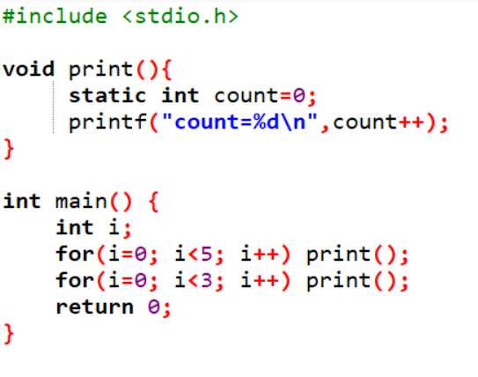
Static keyword
example
Output:
count = 0
count = 1
count = 2
count = 3
count = 4
count = 5
count = 7

Slide 7
Void * Data Type
definition
Function without actual parameter
Keyword void
void main(void){
void *malloc(size_t size);
………
}
A void function
Pointer that can point any data type

Slide 8
Void * Data Type
example
Type void* always use type casting
char *pstr;
int *pint;
float *pfloat;
pstr=(char *)malloc(20);
pint=(int *)malloc(20);
pfloat=(float *)malloc(20);

Slide 9
Const Char *
definition
Description:
  char * : should be a pointer (has an address)
  const char * : can be string or pointer
Example:
  Comparing char * with const char * using strcpy
  char *strcpy( char *strDestination, const char *strSource );
  char ss[20];
  char str[20] = "Good Morning";
  strcpy(ss,"Good Morning");
  strcpy(ss, str);
  strcpy("Hello", ss); //error

Slide 10
Command Line Argument
definition
Some time application should take input parameters from the command line: DOS, Linux e.g.:
  copy file1 file2
  del file3
How to get parameters: file1, file2 and file3?
  Answer: Adding parameters on the main program
  Example:
  int main( int argc, char *argv[ ])

Slide 11
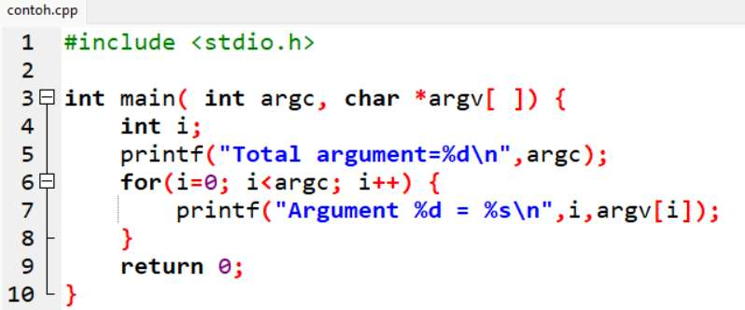
Command Line Argument
example
If the above code run from DOS command or LINUX console will result:
C:\>contoh.exe arg1 arg2 arg3
Total argument=4
Argument 0 = contoh.exe
Argument 1 = arg1
Argument 2 = arg2
Argument 3 = arg3

Slide 12
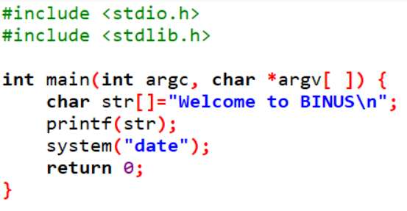
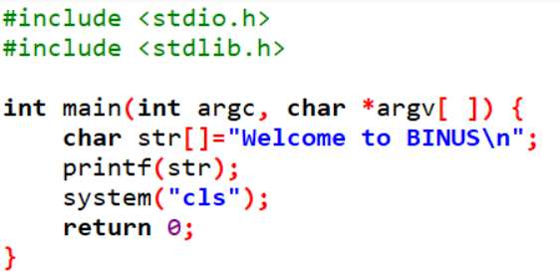
Command execution
example
To execute DOS or LINUX command, we can use library function system(char *)
Example
Output:
Welcome to BINUS
The current date is: Wed 06/18/2025
Enter the new date: (mm-dd-yy)
Output:

Slide 13
Memory Allocation
definition
Memory allocation:
  Acquiring some memory space (RAM) managed by the OS to be used by a program.
Memory de-allocation:
  Releasing memory space (RAM) back to the OS.
Syntax:
int main() {
long nim;
float gpa;
...
}
nim is a variable, nim needs memory space as data store.
gpa is a variable, gpa needs memory as data store

Slide 14
Memory Allocation
definition
Memory Allocation as a data store:
static
  can be assigned with name → variable
  allocated at compile time
  stored at local stack memory
  remain unchanged during the program run
  de-allocated when the program end
dynamic
  can be assigned with name
  allocated at run-time
  stored at heap memory
  can be de-allocated at any time

Slide 15
Memory Allocation
Static Memory Allocation
struct tdata {
char nim[9];
char name[26];
float gpa;
} ;
int main () {
struct tdata data[100];
int i;
...
}
If an integer needs memory space of 4 bytes and a float 8 bytes then variable data and i above need memory space of:
100 x (9 + 26 + 8) + 4 = 4504 byte

Slide 16
Memory Allocation
dynamic Memory Allocation
malloc()
  Function malloc is used to allocate one block of memory dynamically at heap memory. An argument (actual parameter) sent to this function is a value stating the size of allocated memory (in byte)
If allocation is successful, it will return memory address of the memory allocated. If not (e.a: proposed malloc size larger than existing heap memory), it will return Null.
Syntax :
  void * malloc (size_t size);
  size: size of memory in byte.
Example:
  int *a;
  a = (int *) malloc(sizeof(int));

Slide 17
Memory Allocation
dynamic Memory Allocation
calloc()
  Function calloc is used to allocate blocks of memory dynamically at heap memory, where each element given size. Calloc initialized all elements with zero.
Syntax :
  void *calloc(size_t memblock, size_t size);
  size = number of byte ea block or element
  memblock = number of block or element
Example:
  int *a;
  a = (int *) calloc(20,sizeof(int));

Slide 18
Memory Allocation
dynamic Memory Allocation
realloc()
  Function realloc is used to reallocate some blocks of memory or element dynamically at heap.
Syntax :
  void *realloc(void *ptr, size_t size);
  size = number of byte each block or element
  ptr = is a pointer to the address of targeted memory location.
Example:
  int *a, *ptr;
  a = (int *) realloc(ptr,sizeof(int));

Slide 19
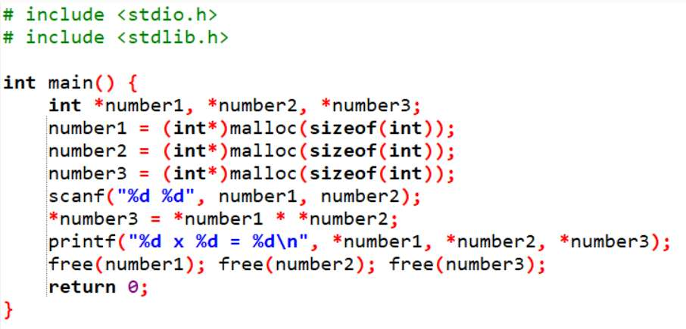
Memory Allocation
dynamic Memory Allocation
free()
  Function free is used to used to release allocated memory at heap memory.
Syntax :
  void free (void *block);
  block is a pointer to a memory location (dynamic)
Example:

Slide 20
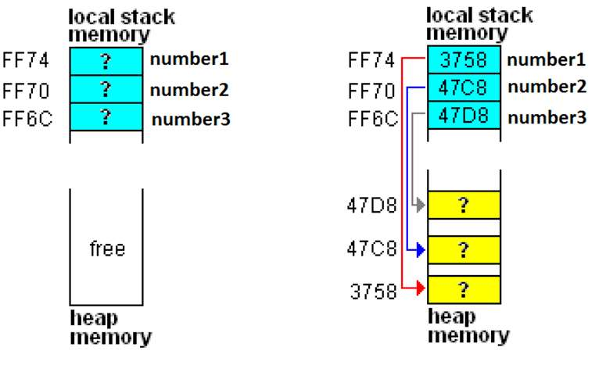
Memory Allocation
integer Memory Allocation
int *number1, *number2, *number3;
number1 = (int *) malloc (sizeof(int));
number2 = (int *) malloc (sizeof(int));
number3 = (int *) malloc (sizeof(int));

Slide 21
Memory Allocation
array Memory Allocation
# include <stdio.h>
# include <stdlib.h>
int main() {
int *arr, n, i;
do {
printf("total element ? ");
scanf("%d", &n);
if(n == 0) break
arr = (int*) malloc (n * sizeof(int));
for (i = 0; i < n; i++) scanf("%d", &arr[i]);
free(arr);
}while(1);
return 0;
}

Slide 22
Memory Allocation
array Memory Allocation
# include <stdio.h>
# include <stdlib.h>
int main() {
int *arr, n, i;
do {
printf("total element ? ");
scanf("%d", &n);
if(n == 0) break
arr = (int*) malloc (n * sizeof(int));
for (i = 0; i < n; i++) scanf("%d", &arr[i]);
free(arr);
}while(1);
return 0;
}
total element ? 3

Slide 23
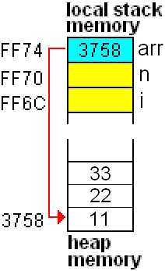
Memory Allocation
array Memory Allocation
# include <stdio.h>
# include <stdlib.h>
int main() {
int *arr, n, i;
do {
printf("total element ? ");
scanf("%d", &n);
if(n == 0) break
arr = (int*) malloc (n * sizeof(int));
for (i = 0; i < n; i++) scanf("%d", &arr[i]);
free(arr);
}while(1);
return 0;
}
total element ? 3
Input 3 numbers: 11 22 33

Slide 24
Memory Allocation
Pointer of struct Memory Allocation
# include <stdio.h>
# include <stdlib.h>
struct takad {
char nim[9];
float gpa;
};
int main() {
struct takad *akad;
  akad = (struct takad*)malloc(sizeof(struct akad));
  return 0;
}

Slide 25
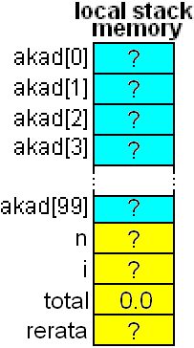
Memory Allocation
Array of struct pointer memory allocation
# include <stdio.h>
# include <stdlib.h>
struct takad {
char nim[9];
float gpa;
} ;
int main() {
struct takad *akad[100];
int n, i;
float total = 0, rerata;
  return 0;
}

Slide 26
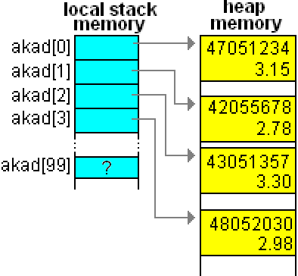
Memory Allocation
Array of struct pointer memory allocation
for(i = 0; i < n; i++){
  akad[i]=(struct takad*) malloc(sizeof(struct takad));
}

Slide 27
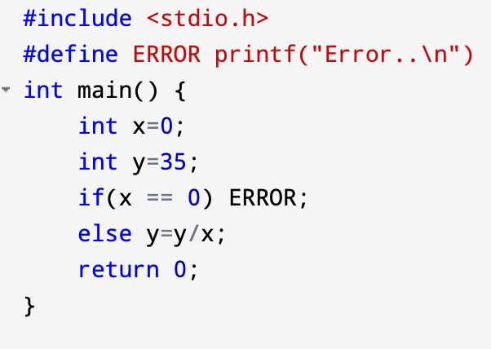
macro
definition
Using #define
Placed at the beginning of a code
Its scope starts at its declaration position to the end of a program.
A macro is not recognized by other program.
Output:
Error..

Slide 28
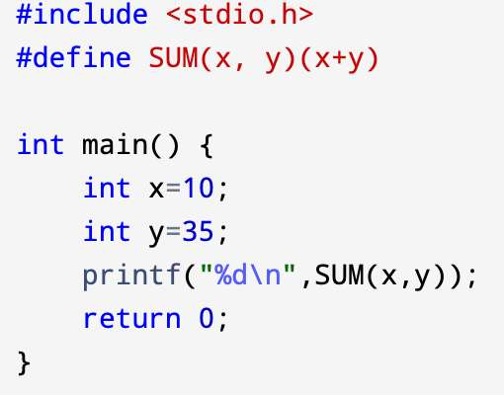
macro
example
Output:
45

Slide 29
Pointer to Functions
definition
Pointer to function is the address of a function in the memory
Syntax:
  return_type (* pointer_name)(parameter);
Example:
  int (*compare)(int a, int b);
  **note: compare is pointer to function name, pointing to a function that return integer value which has 2 integer parameters
Note the difference:
  int compare (int a, int b);
  **Means: compare is a function name with integer return value that has 2 integer parameters

Slide 30
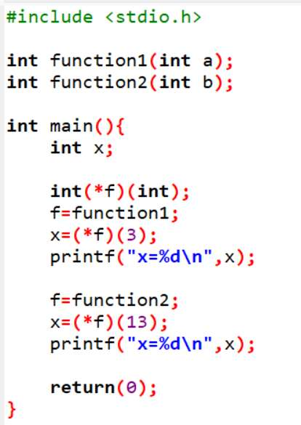
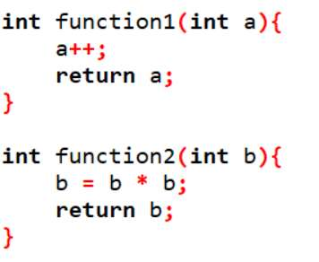
Pointer to Functions
Example
Output:
x=4
x=169

Slide 31
C Preprocessor Directive
definition
Process is done before compilation.
Preprocessor directive started with symbol #
Example :
#include <filename>
#include ”namafile”
#define identifer replacement-text
#define PHI 3.14
Preprocessor #define also used for macro

Slide 32
C Preprocessor Directive
definition
Conditional Compilation
#if expression
……
#endif
OR
#if expression
……
#else
……
#endif
Preprocessor operator defined :
Syntax :
  defined( identifier )
  defined identifier
Return true (nonzero) if identifier has been defined and false (0) if not.

Slide 33
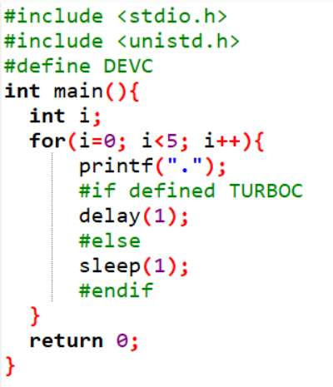
C Preprocessor Directive
example
This program is to be compiled in Dev-C
Dev-C does not have delay() as in Turbo C, but using sleep() instead.
To write a code compliable to both compiler, then this preprocessor example can be used.

Slide 34
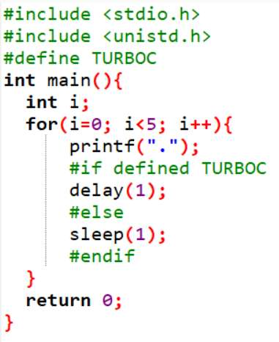
C Preprocessor Directive
example
This program is to be compiled in Turbo-C

Slide 35
exercise
Question 1
Using <malloc.h> describe the following function!
void *malloc ( size_t size );
void *calloc ( size_t num, size_t size );
void *realloc ( void *memblock, size_t size );
void free ( void *memblock );
Question 2
void (*ptr[3])(int)= {function1. function2, function3};
Describe the above code!

Slide 36
exercise
Question 3
Describe the following preprocessor directive:
#ifdef
    ……
  #endif
#error
#pragma
#line
#ifndef
    ……
  #endif

Slide 37
exercise
Question 4
C language provides the following predefined symbolic constant:
__LINE__
__FILE__
__DATE__
__TIME__
Describe each symbolic constant above!
Question 5
Describe the pro-cons of using macro along with a function!

Slide 38
SUMMARY
Memory allocation:
  acquiring some memory space (RAM) managed by the OS to be used by a program
Memory de-allocation:
  releasing memory space (RAM) back to the OS

Slide 39
REFRENCES
Paul Deitel & Harvey Deitel. (2021). C how to program. 09. Pearson Education. New York. ISBN: 9780137398393.
C - Storage Classes: http://www.tutorialspoint.com/cprogramming/c_storage_classes.htm
C Programming - Dynamic Memory allocation: http://www.exforsys.com/tutorials/c-language/dynamic-memory-allocation-in-c.html

